Slide 1
Migration to GitHub

Slide 2
GitHub signup
Git Basic Knowledge
Git for Windows
Typical Use Case
Git with VisualStudio, Eclipse, Jenkins
SVN to Git
Migration Plan

Slide 3
Open Account in GitHub
Register with company email ( must use firstname.lastname@webtechwireless.com for Webtech team )
Forward account name to me

Slide 4
Git Basic
Git Introduction (https://www.atlassian.com/git/tutorials/setting-up-a-repository )
Simple Git Guide (http://rogerdudler.github.io/git-guide/)
Git Document (http://git-scm.com/book/en/v2/Getting-Started-Git-Basics )

Slide 5
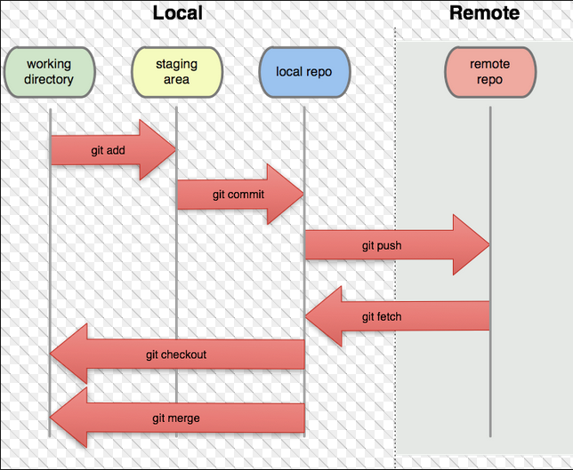

Slide 6
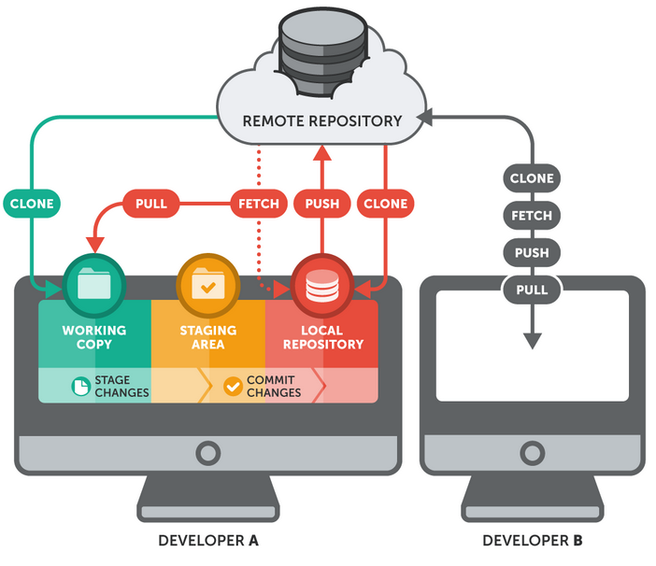

Slide 7
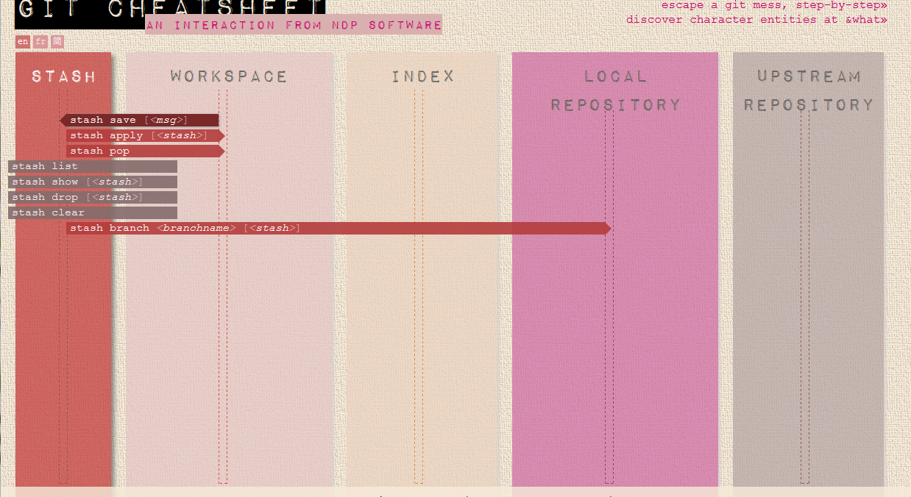
Git CheatSheet
Interactive Git cheatsheet http://www.ndpsoftware.com/git-cheatsheet.html

Slide 8
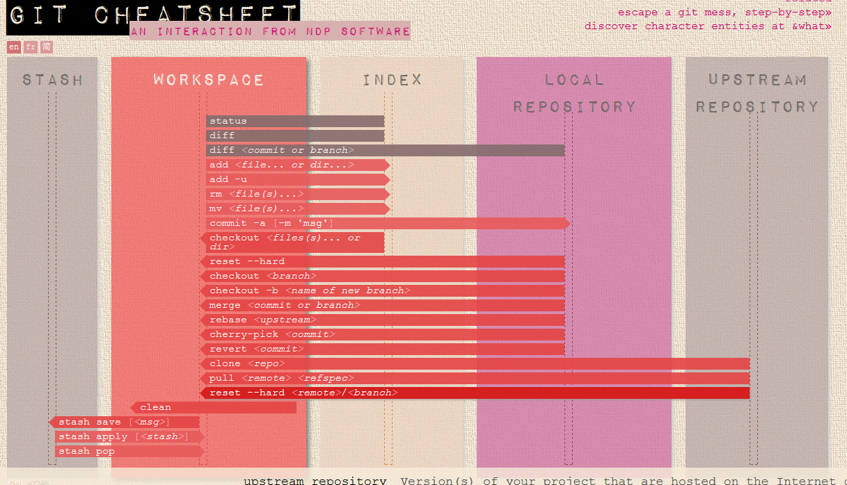

Slide 9
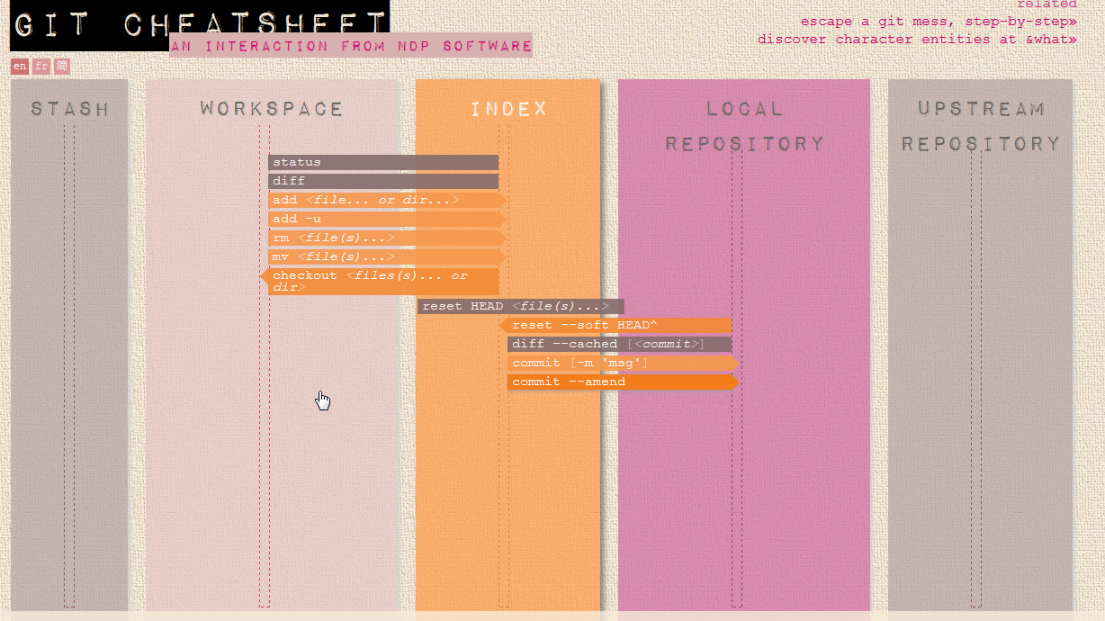

Slide 10
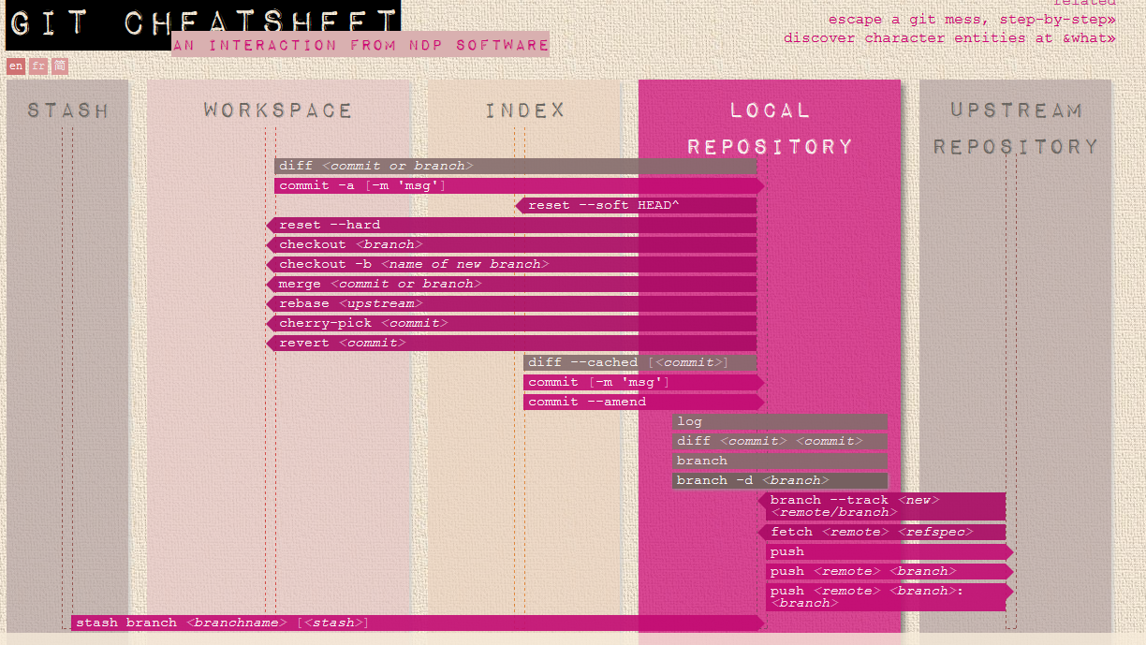

Slide 11
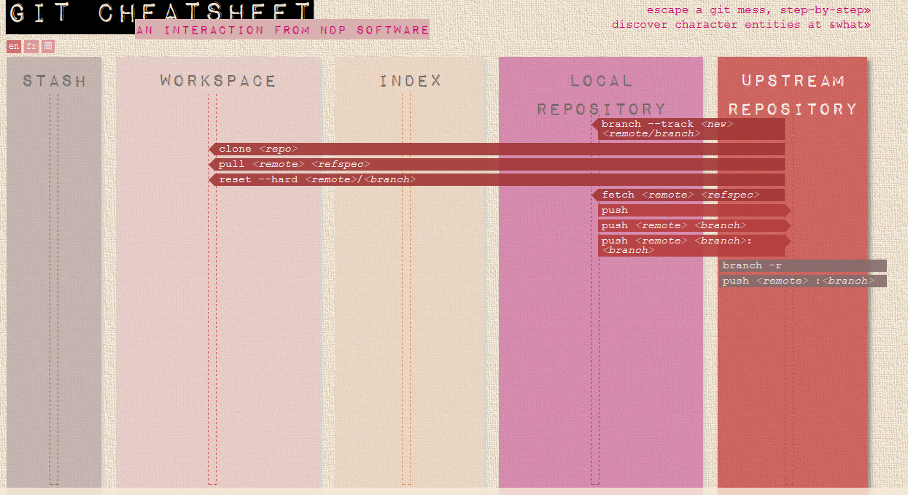

Slide 12
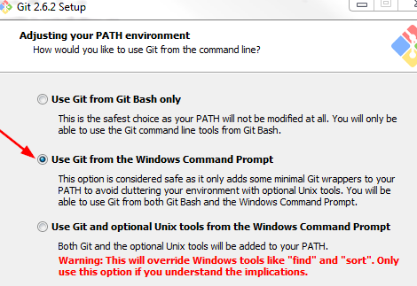
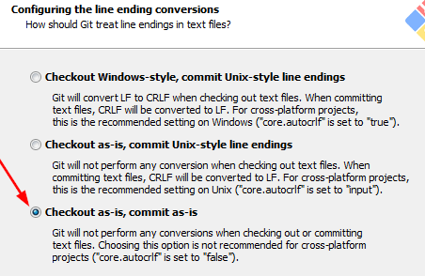
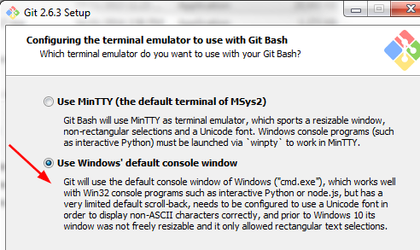
Git for Windows Setup
Windows Setup
Download Git for Windows (https://git-for-windows.github.io/) and TortoiseGit
Install “Git for Windows”
Choose to install as “Administrator” ( so it will be installed under “Program File” folder, otherwise Git will be installed under your account )
During the installation, please choose following option

Slide 13
Verify installation
Open “Command Prompt”
Type “git –version” to check Git path is configured
Install TortoiseGit

Slide 14
Workflow with Git
Please read following tutorial for workflow in Git
A successful Git branching model ( http://nvie.com/posts/a-successful-git-branching-model/ )
Compare working flow (https://www.atlassian.com/git/tutorials/comparing-workflows )

Slide 15
Typical Use Cases
Checkout working copy of existing repository from GitHub
Checkout selected directory(files) only (sparse checkout )
cd <your working dir>
git clone https://github.com/bsmwireless/REPOSITORY-Name.git
Check Answer from: http://stackoverflow.com/questions/600079/is-there-any-way-to-clone-a-git-repositorys-sub-directory-only

Slide 16
Create new project and upload to GitHub
Create a new repository on GitHub
Prepare your local project repository
Add files to local repository
Push to GitHub
cd <your working dir>
git init
git add .
git commit –m “comments for the commit”
git remote add origin https://github.com/bsmwireless/<Repository-Name>.git
git push origin master

Slide 17
Modify files, Commit changes and Push to GitHub
Add changes in specified file or files of directory to stage
Check file status before Commit
Commit changes to local repository
Push changes to
Pull updates then Push ( ensure you get most-to-update version)
git add <file>
git add <directory>
git status
git commit –m “comments for the commit”
git push orgin master
git pull –rebase
git push orgin master

Slide 18
Get old version files
Check commit history to get commit id
Check out the selected file from that commit to working copy
Combine multiple changes into one commit
It lets you combine staged changes with the previous commit instead of committing it as an entirely new snapshot. It can also be used to simply edit the previous commit message without changing its snapshot.
git log
Git checkout <old_commit> <file>
git add <file>
git commit –-amend –-no-edit
OR
git commit –-amend –m “new comments”

Slide 19
Sync with remote repository
If you have working copy that may conflict with remote update.
Do “fetch” first, then “merge” into your working copy
Otherwise, run “git pull” will do the “merge” automatically
git fetch origin
git pull

Slide 20
Branch, Develop and Merge to master
Create new branch
Checkout new branch based on existing branch ( such as master ), then switch working copy to new branch
Do your development and commit the changes
Merge branch to master and delete the branch
git branch <new branch name>
git checkout <new branch name> <existing branch name>
git add <file>
git commit –m “comments”
git checkout master
git pull
git merge <branch name> --no-ff
git branch –d <branch name>

Slide 21
Create Tag
Show commit history first
Create a tag
Push to remote repository
Checkout Tags
Must create new branch at a specific tag
git log –pretty=oneline
15027957951b64cf874c3557a0f3547bd83b3ff6 Merge branch 'experiment‘
a6b4c97498bd301d84096da251c98a07c7723e65 beginning write support
0d52aaab4479697da7686c15f77a3d64d9165190 one more thing
6d52a271eda8725415634dd79daabbc4d9b6008e Merge branch 'experiment'
git tag -a v1.2 9fceb02 –m ”tag description”
git push origin v1.2
git checkout –b <branch name> <tag name>

Slide 22
How to check out
Checkout from GitHub ( with Git command line )
Create a directory for your workspace, then enter this directory
Run command “git clone <GitURL>”
Do some configuration setup ( user, email ..)
Remember your account password (http://superuser.com/questions/199507/how-do-i-ensure-git-doesnt-ask-me-for-my-github-username-and-password )
git clone https://github.com/bsmwireless/WFC.Report.Advanced.git
Cloning into 'WFC.Report.Advanced'...
Username for 'https://github.com': waynehu2008
Password for 'https://waynehu2008@github.com':
remote: Counting objects: 2173, done.
remote: Compressing objects: 100% (577/577), done.
d R0 ei
Receiving objects: 100% (2173/2173), 2.11 MiB | 1.68 MiB/s, done.
Resolving deltas: 100% (1537/1537), done.
Checking connectivity... done.
git config –global user.name “Your Name”
Git config --global user.email me@email.com

Slide 23
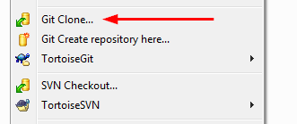
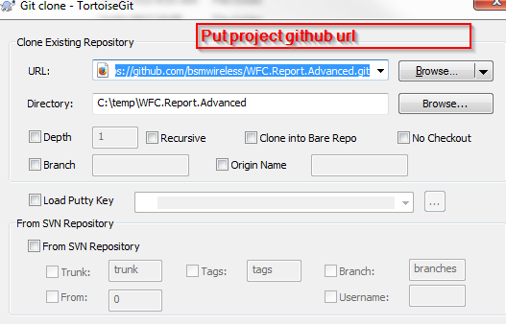
Checkout from GitHub ( with TortoiseGit )
Open context menu, select “Git Clone”
Enter your project GitHub URL, click OK to check out whole project

Slide 24
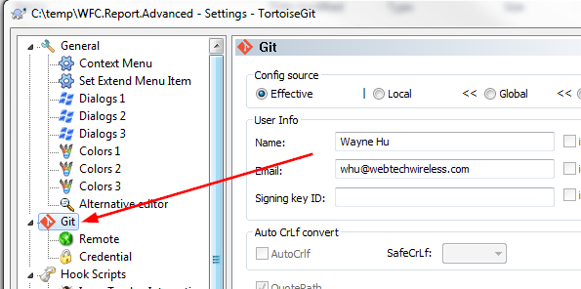
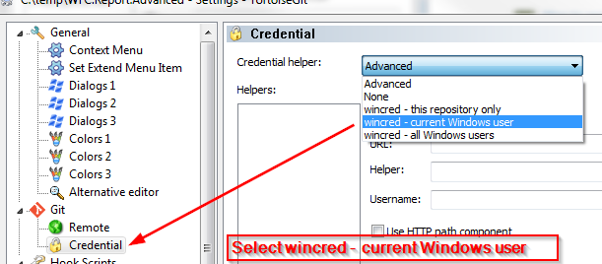
How to remember password
TotoriseGit Configuration for username, email. ( TotoriseGit -> setting -> Git )
Remember password ( TotoriseGit -> Setting -> Git -> Credential )

Slide 25
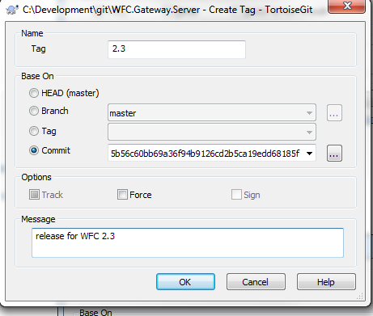
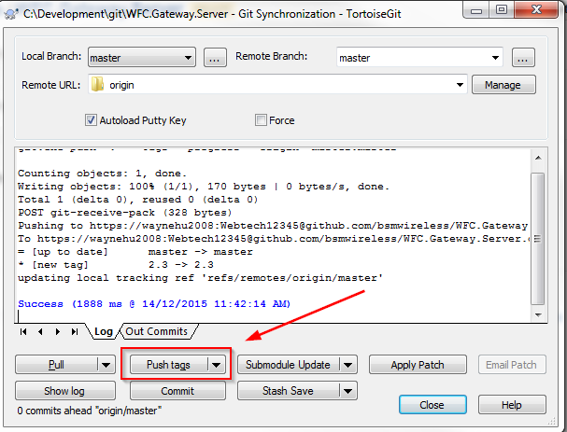
Tag the Release
For each release, we must create a tag in Git.
Using GitHub Web (http://stackoverflow.com/questions/18216991/create-a-tag-in-github-repository )
Using TotoriseGit
Totorise Git Menu -> Create Tag
Choose “Head” to create tag based on latest changes
Or
Select commit from change logs for the tag
TotoriseGit Menu -> Git Sync
Click “Push Tags” to upload changes to GitHub

Slide 26
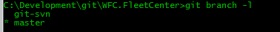
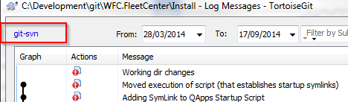
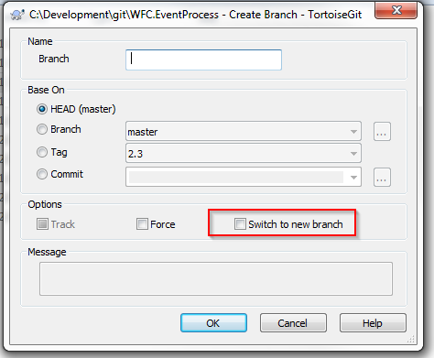
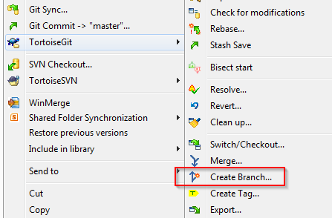
How to branch
Check which branch you are working ( which has * indicator )
Create(and switch) to new branch from an existing branch head
Command line
TortoiseGit
git branch <new_branch> <existing_branch>
git checkout –b <new_branch> <existing_branch>

Slide 27
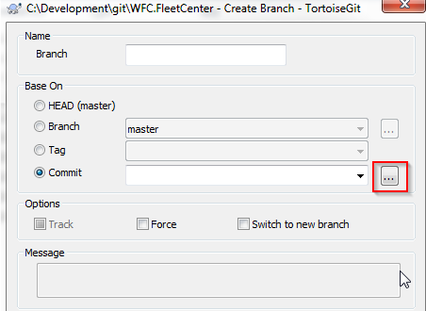
Create branch from specific commit
Command line
TortoiseGit
Create branch from tag
Command line
TortoiseGit
git branch <new_branch> a9c146a09505837ec03b
git branch <new_branch> <tag_name>

Slide 28
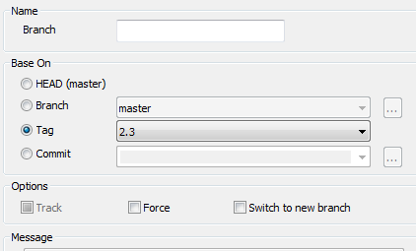
TortoiseGit

Slide 29
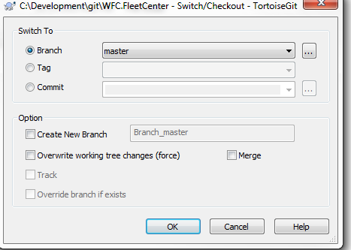
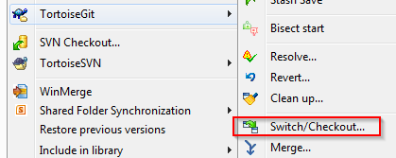
Switch branch
A clean switch
No uncommitted changes on working copy. Git will switch your workspace to specified branch
Local changes will be kept if both branch on the changed file has same history commit
Discard local changes on working copy
All untracked files will be kept in workspace after branch switch
The local changes on tracked files (event staged files) will be discarded
git checkout <branch_name>
git checkout -f <branch_name>

Slide 30
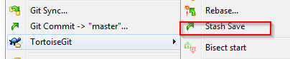
Save local changes and apply back
All untracked files will be kept
The command saves your local modifications away and reverts the working directory to match the HEAD commit.
git stash save “stash summary”
git checkout <branch_name_A>
... Complete the work on branchA and revert back master
git checkout master
git stash apply

Slide 31
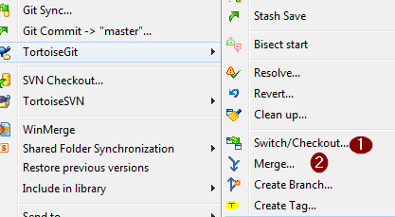
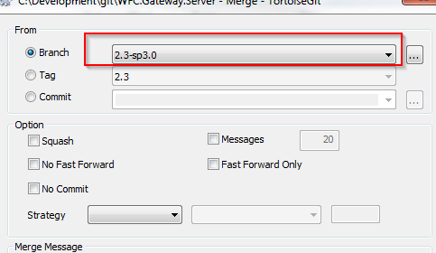
Merge changes from branch
Merge changes of one branch to another ( make sure no uncommitted changes)
Command line
TortoiseGit ( checkout, merge )
git checkout master
git merge –-no-ff <branch_name>

Slide 32
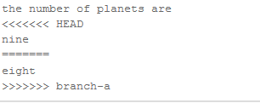
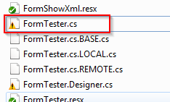
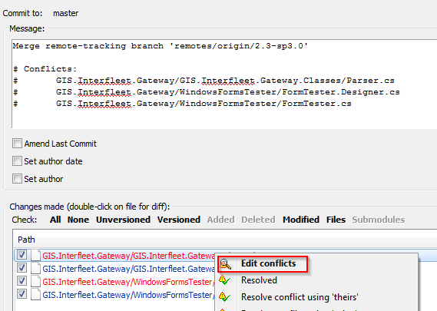
Resolve Conflicts ( Torgoise Git)
Conflict indicator
Manually edit the conflict file OR through some tools
Once done. Select “Conflict Resolved” in torgoisegit
Commit the changes to Git

Slide 33
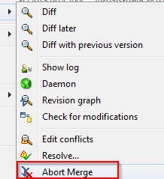
Undo Merge
Abort the current conflict resolution process: return to the state before you started the merge
Undo merge
git merge –-abort
git reset --hard

Slide 34
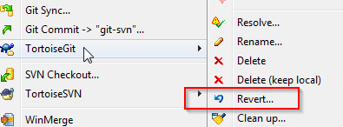
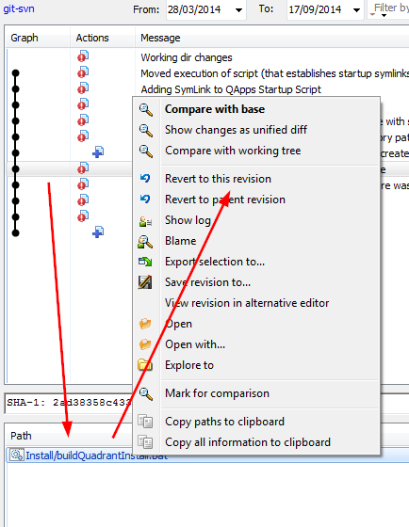
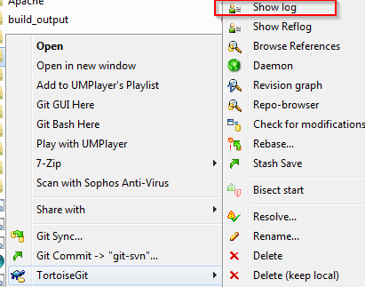
Undo changes
Discard changes on unstaged files
Back to historical commit
git checkout <file name>
git checkout <commit > <file name>

Slide 35

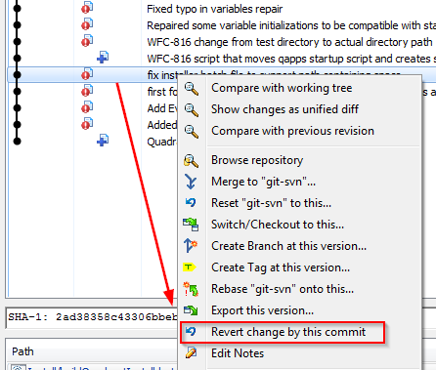
Undo a commit
Undo is not remove commit from history. It “undo changes” and append a new commit with resulting contents
Remove staging files ( but still keep the changes )
git revert <commit >
git reset <file >

Slide 36
Force sync with remote
Force local repository to match with remote
In order to clean up some messy in local repository and make the local repository exactly match the remote tracking branch (http://stackoverflow.com/questions/1125968/force-git-to-overwrite-local-files-on-pull)
git fetch –all
git reset --hard origin/<branch name>

Slide 37
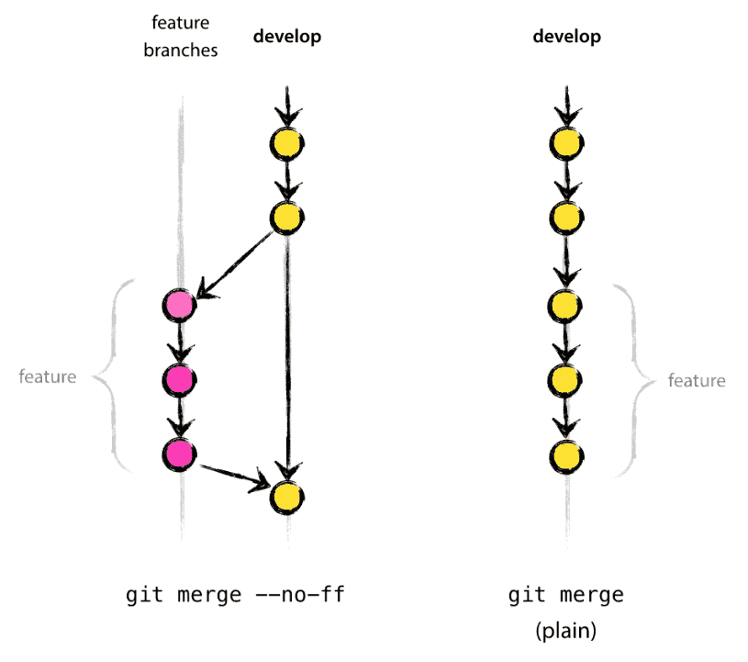
Merge with -- no-ff
When merge branch, add “—no-ff” flag
The --no-ff flag causes the merge to always create a new commit object, even if the merge could be performed with a fast-forward. This avoids losing information about the historical existence of a feature branch and groups together all commits that together added the feature. Compare:
In the latter case, it is impossible to see from the Git history which of the commit objects together have implemented a feature—you would have to manually read all the log messages. Reverting a whole feature (i.e. a group of commits), is a true headache in the latter situation, whereas it is easily done if the --no-ff flag was used.

Slide 38
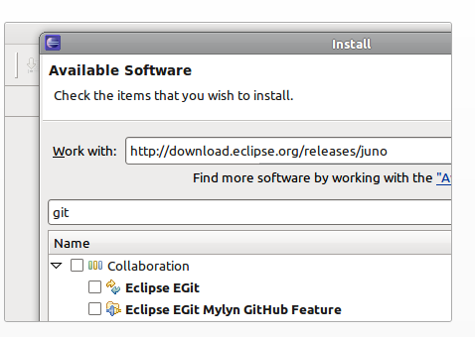
Git for Eclipse
Egit (http://eclipse.github.io)
Install software through Eclipse – Help – Install New Software, choose “Juno” link
Search 'git' in the filter box. Once you've selected the EGit, JGit, and Mylyn GitHub items hit Next to finish the installation.
Tutorial of Egit (http://eclipsesource.com/blogs/tutorials/egit-tutorial/)

Slide 39
Git for VisualStudio
VS2013 tutorial ( http://michaelcrump.net/setting-up-github-to-work-with-visual-studio-2013-step-by-step/ )
VS2015 tutorial (https://visualstudio.github.com/ )

Slide 40
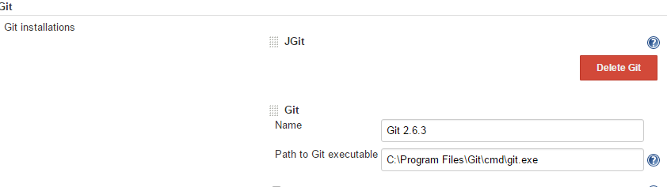
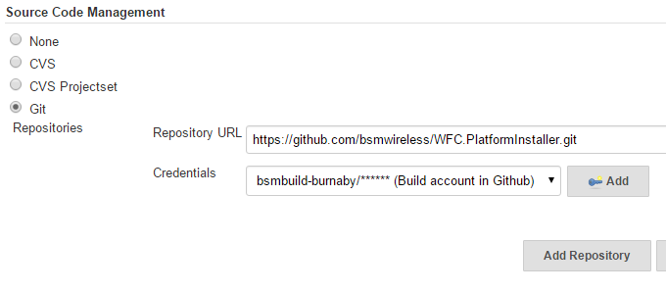
Git for Jenkins
Download and install “git plugin”
Configure Git in Jenkins – Configuration ( either use JGit or install external Git )
Change “Source Code Management” for each project

Slide 41
SVN Migration
Install SVN2Git(https://github.com/nirvdrum/svn2git)
Create user mapping file
list all SVN committer name
Save the name mapping into text file
Convert SVN to Git repository
If SVN repo is in the standard layout of (trunk, branches, tags) at the root of the repo
If SVN repo only has ‘trunk’ at root of the repo
svn log --quiet <URL of SVN Project> | grep -E "r[0-9]+ \| .+ \|" | cut -d'|' -f2 | sed 's/^ //' | sort | uniq
Example
svn log --quiet http://devserv01:9880/quadrant/Tools/TestTools/DriverCenter | grep -E "r[0-9]+ \| .+ \|" | cut -d'|' -f2 | sed 's/^ //' | sort | uniq
Waynehu=Wayne Hu <whu@webtechwireless.com>
svn2git http://svn.example.com/path/to/repo --authors authors.txt
svn2git http://svn.example.com/path/to/repo --trunk trunk --notags --nobranches --authors authors.txt

Slide 42
If SVN repo is NOT in standard layout and has no trunk, branches, or tags at the root level of the repo. Instead the root level of the repo is equivalent to the trunk
If SVN repo hosted for multiple projects and only convert selected one
Import local repository to GitHub
Create new repo in GitHub to get the ‘git’ url
Import the project to GitHub
NOTE: empty directory is not tracked by Git
(http://stackoverflow.com/questions/115983/how-can-i-add-an-empty-directory-to-a-git-repository )
svn2git http://svn.example.com/path/to/repo --rootistrunk --authors authors.txt
svn2git http://devserv01:9880/quadrant/DriverCenter --no-minimize-url --authors authors.txt
git remote add origin https://github.com/bsmwireless/WDC-Test.git
git push -u origin master

Slide 43
Migrate Plan
SVN project | Git project | Status
DriverCenter Test | WDC.Test | Done
WFC Platform Installer | WFC.PlatformInstaller | Done
WFC DGWGatewayWFC | WFC.Gateway.Server | Done
WFC Connector API | WFC.Connector.API | Done
WFC Report WebApp | WFC.Report.WebApp | Done
WFC Report | WFC.Report.Advanced | Done
WFC Installer | WFC.Installer | Done
DriverCenter | WDC.DriverCenter | Done
WFC DB | WFC.DB | Done
WFC EventProcess | WFC.EventProcess | Done
WFC FleetCenter | WFC.FleetCenter | Done
WFC 511
W10x
SentinelDrive

Slide 44
Thank You !

